Slide 1


Group 6
Sameer Barretto
Brayan Alfonso
Aayush Shah
Rory Dune
Anirudh Sharma

Slide 2


Apprisen challenge statement:
How can Apprisen help Debt Management Program participants successfully graduate from the program at a higher rate? Apprisen would like an app that allows the cllients to find the information about their program, track their progress with a motivational visual representation, and access tools/resources cultivated exclusively for them. Additional features would include the ability to communicate through the app, send push notifications, and encourage the participants with motivation tools.

Slide 3
Our goal:
Create an app that satisfies our Nonprofit Organization needs, by including features such as:
Debt Tracker(Balance, Payment, Interest Rate, Estimate time to completition)
Budget (Income)
Payment Reminders (Push/Email/Text/Phones)
Nest egg tracker(Savings Account)
Appointment Scheduling
Find nearby locations

Slide 4
How does our proposed solution respond to the challenge statement?

Slide 5
Motivational Visual Representation:
Balance Summary
Different Goal Steps --- Motivational Tiers
One More payment until you are 25%, 50%, 75%
of your goal

Slide 6
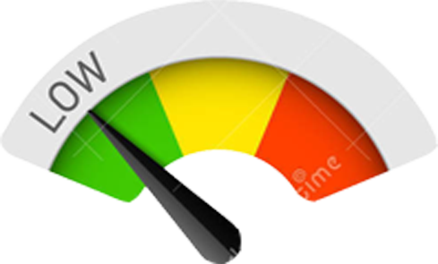




Motivational Visual Representation:
See how your Credit Score has risen
Color for levels of accomplishment:

Slide 7
Motivational Visual Representation:
See how your Credit Score has risen
Color for levels of accomplishment:

Slide 8


Motivational Visual Representation:
Missed Payment ?
Get back on track!
Do you want to talk to someone?
*** All about motivation ***

Slide 9
This Photo by Unknown Author is licensed under CC BY-SA

